Slide 1
A miracle
Law Wing Lam , Winnie

Slide 2
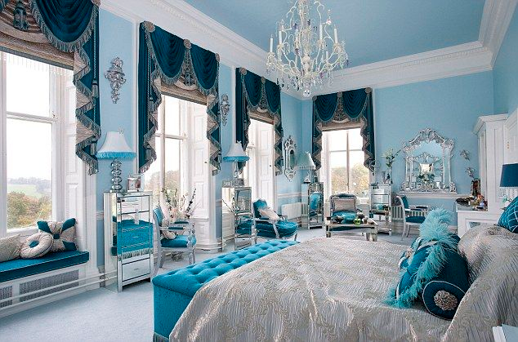
Scene 1: In the princess’s room
King David: (worriedly): My dear, I am getting old. It’s time to find a prince to
look after you. I need to find you a nice young man.
(The next day: At sunrise, the king orders the finest man to come to the castle. A young man walks up to the king.)
Prince Billy: Let me try. I promise I can wake her up. Please give me a chance.
King David: Alright. Go ahead.

Slide 3
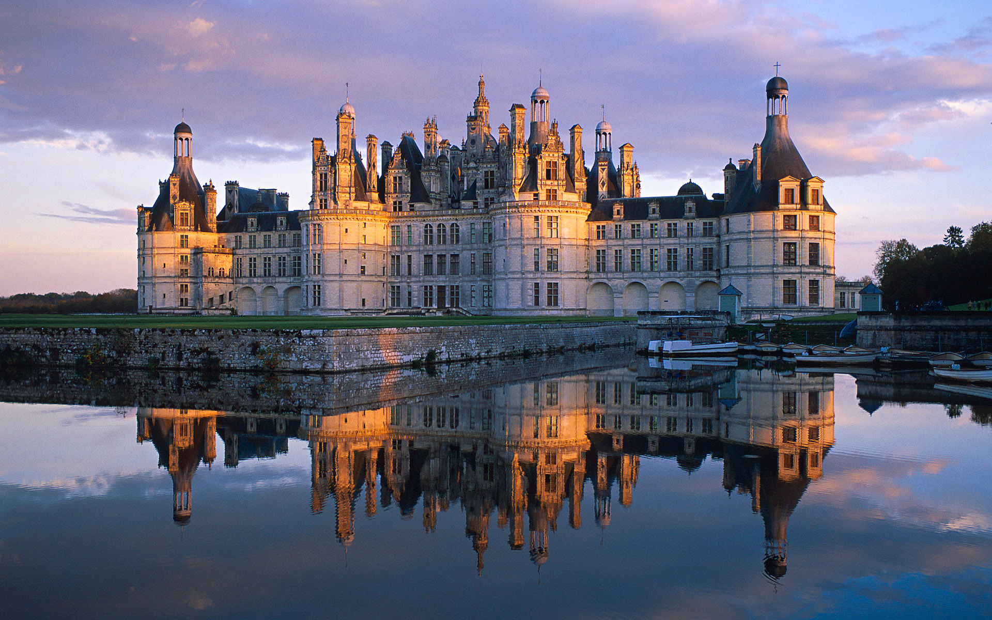
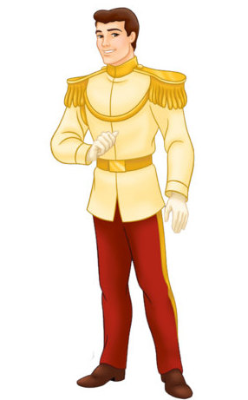
Scene 2:In the prince’s castle
(Prince Billy takes King David and beauty Princess Kelly to his immensely massive castle.Prince Billy takes some magical medicine and feeds Princess Kelly .)
Prince Billy : King David, don't worry. I'm sure she will wake up.
King David:(worriedly)OK.
Narrator: After few minutes, Princess Kelly wakes up! It is extremely fabulous. She smiles highly attractive. Everyone smiles too. King David hugs his dreadfully lovely daughter.
King David:(hugs his daughter) My dear. I'm so worried about you.
Princess Kelly: Father, who wakes me up?
King David:(point to Prince Billy)Kelly,it's him. He is a handsome boy.

Slide 4

Princess Kelly : Thank you ! How did you wake me up?
Prince Billy : Actually, I am a boy who knows magic . So , I have some magical medicine . It can wake someone up if he is sick!
Princess Kelly and King David: Wow ! That's deeply amazing!
Narrator : King David is so thankful that Prince Billy can wake Princess Kelly up. So , he decided to have a good dinner with Prince Billy . They feel very merry.

